Slide 1

Distributed Grading System
Furkan Can Özer – 17290115
Murat Yıldırım – 17290132
Alptekin Yanık – 17290130
Elif Hale Gökçen – 19290803
Rozana Mamoun Saleem- 20291229

Slide 2

Admin

Slide 3
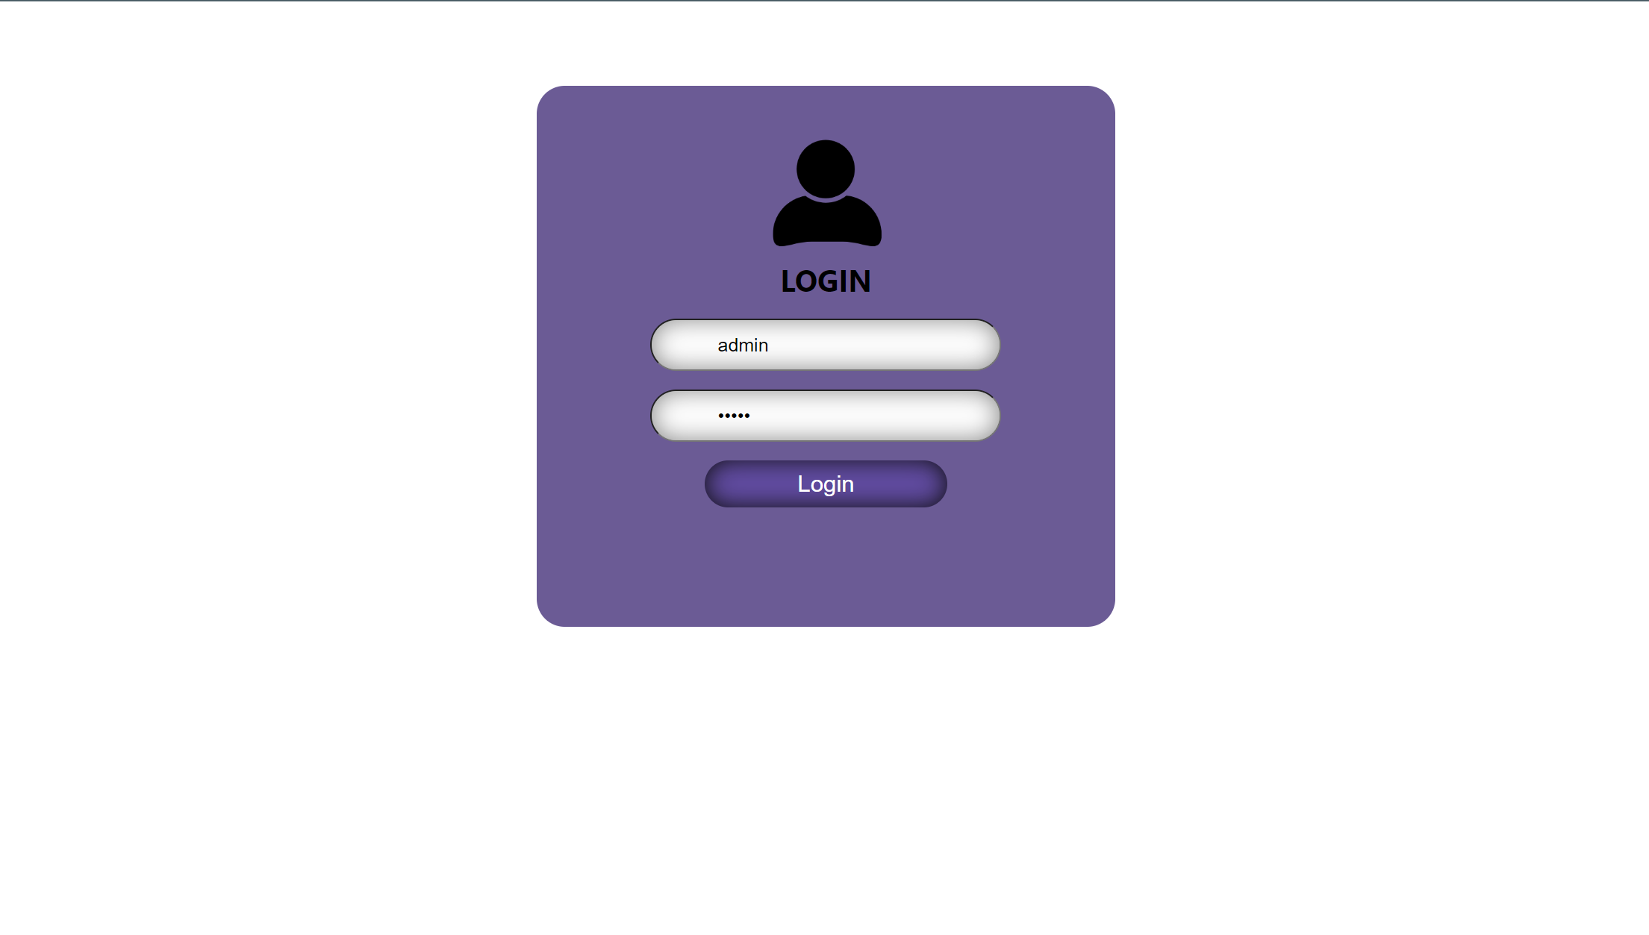
Admin-Login

Slide 4
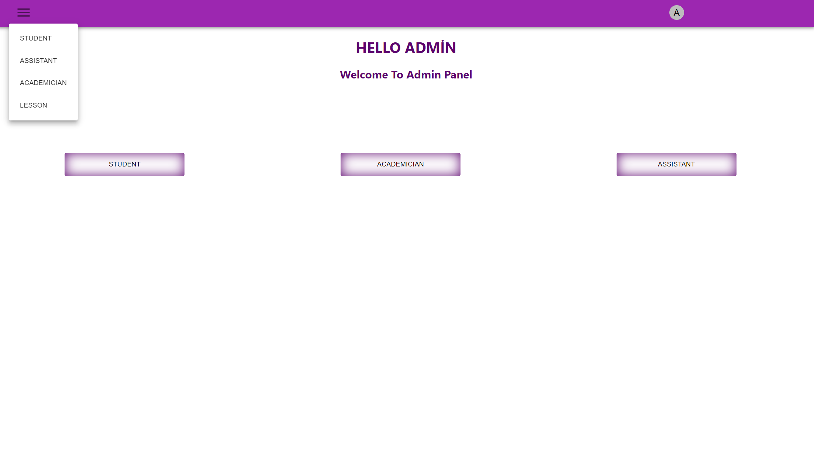
Admin-Main

Slide 5
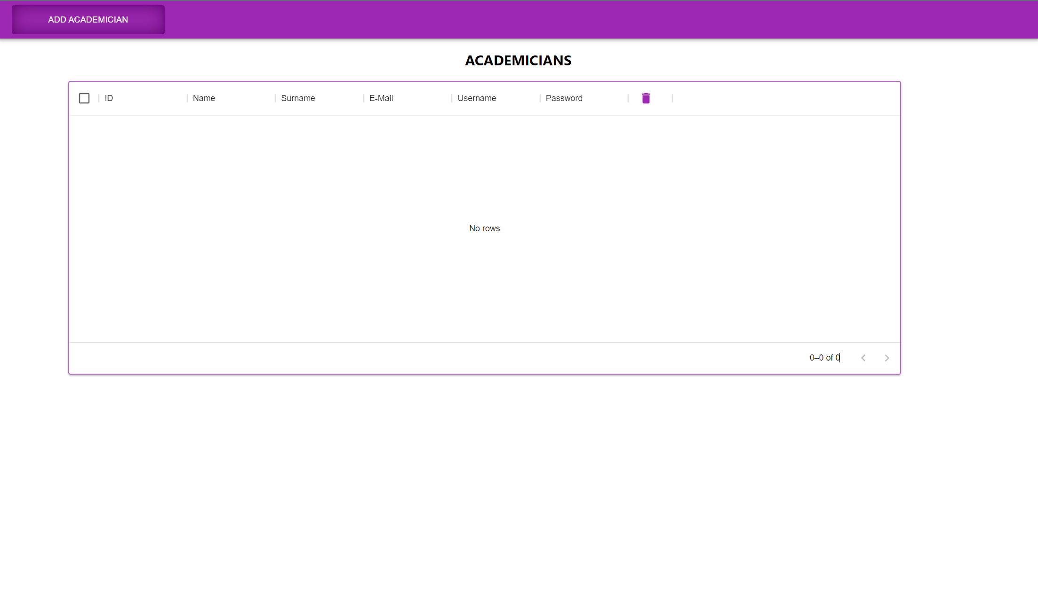
Admin – Add - Academicians

Slide 6
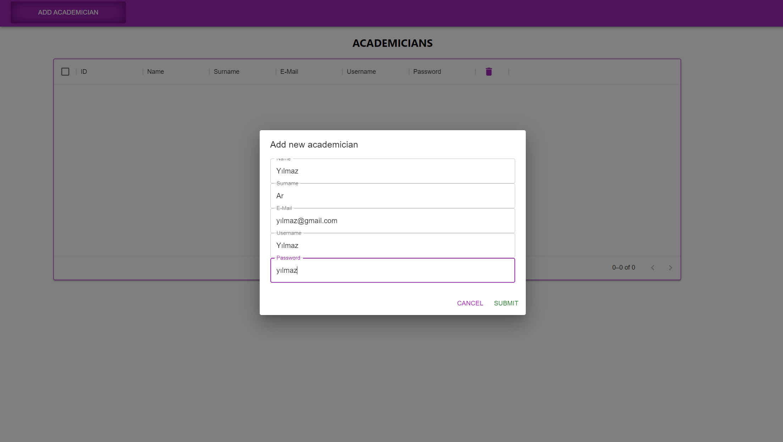
Admin – Add - Academicians

Slide 7
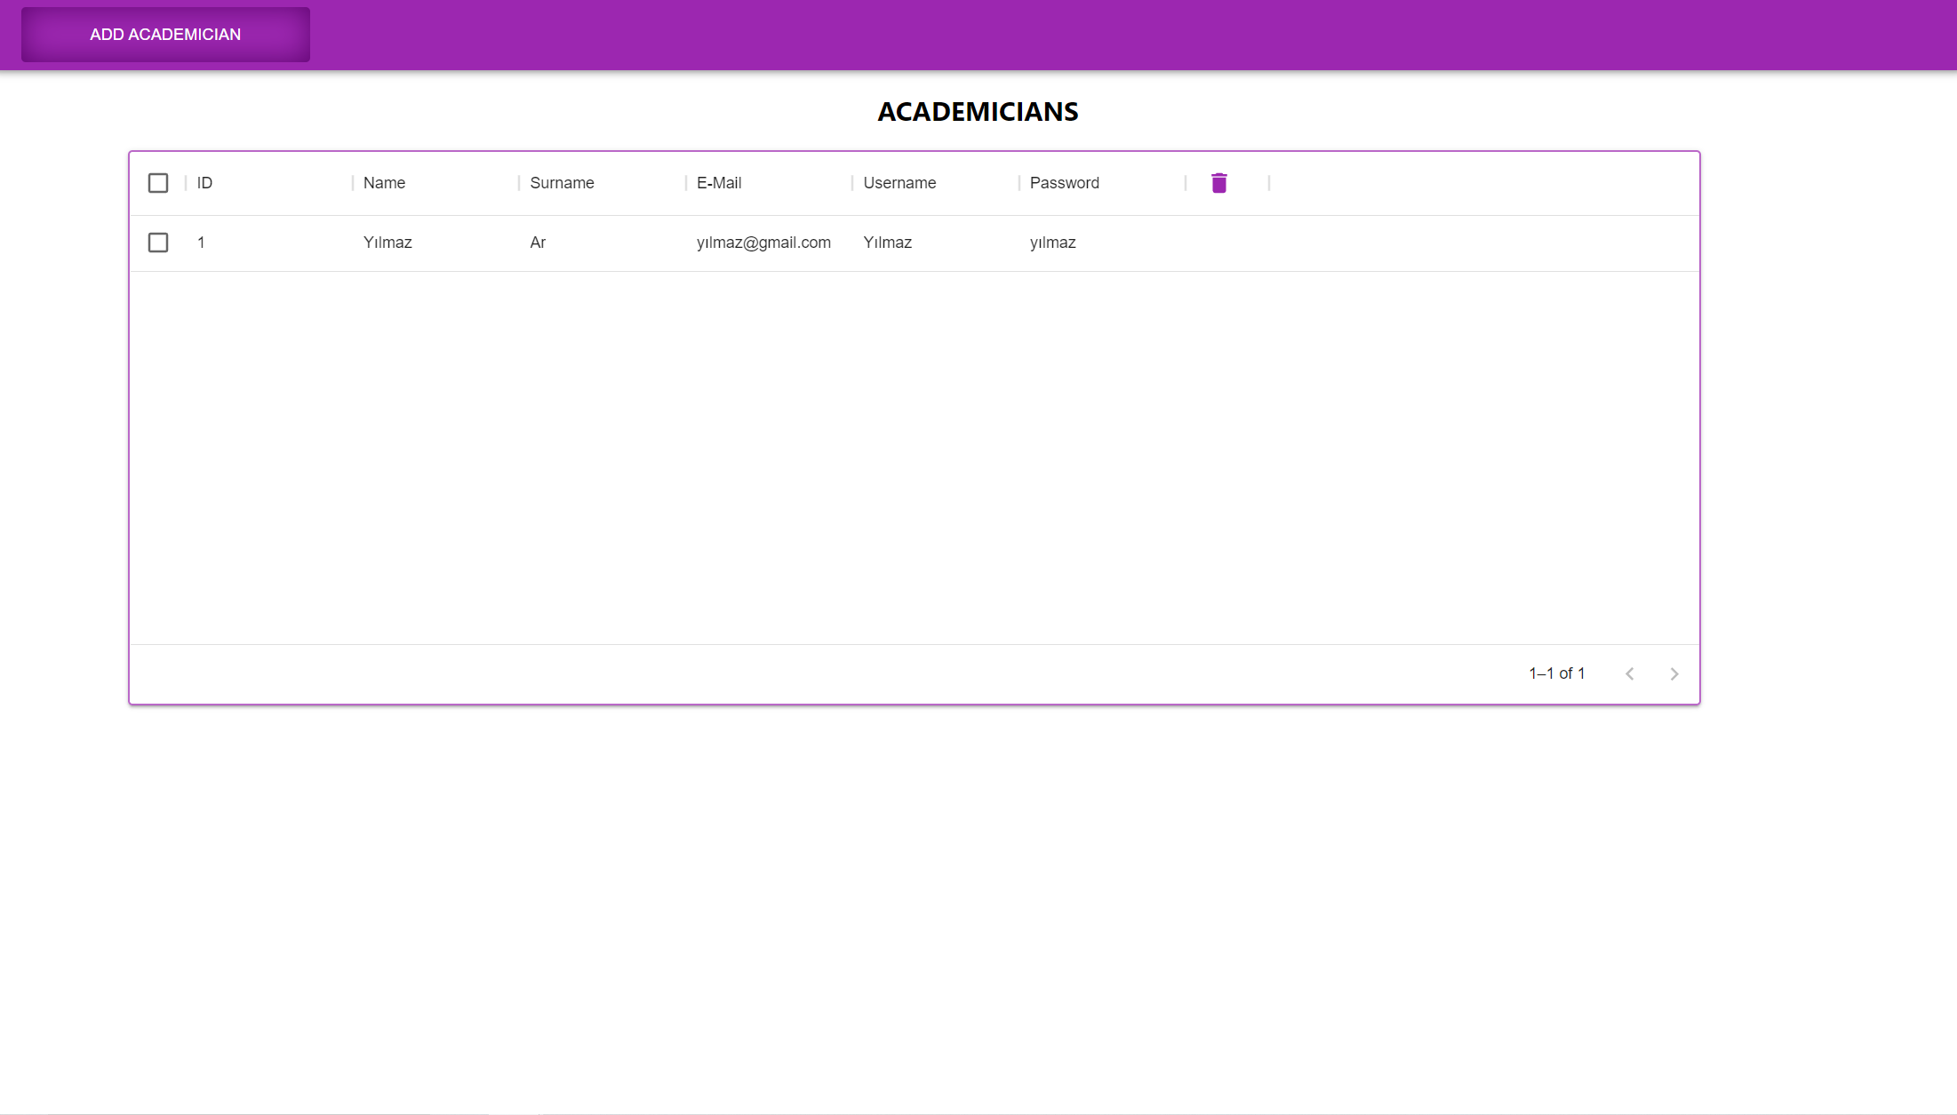
Admin – Add - Academicians

Slide 8
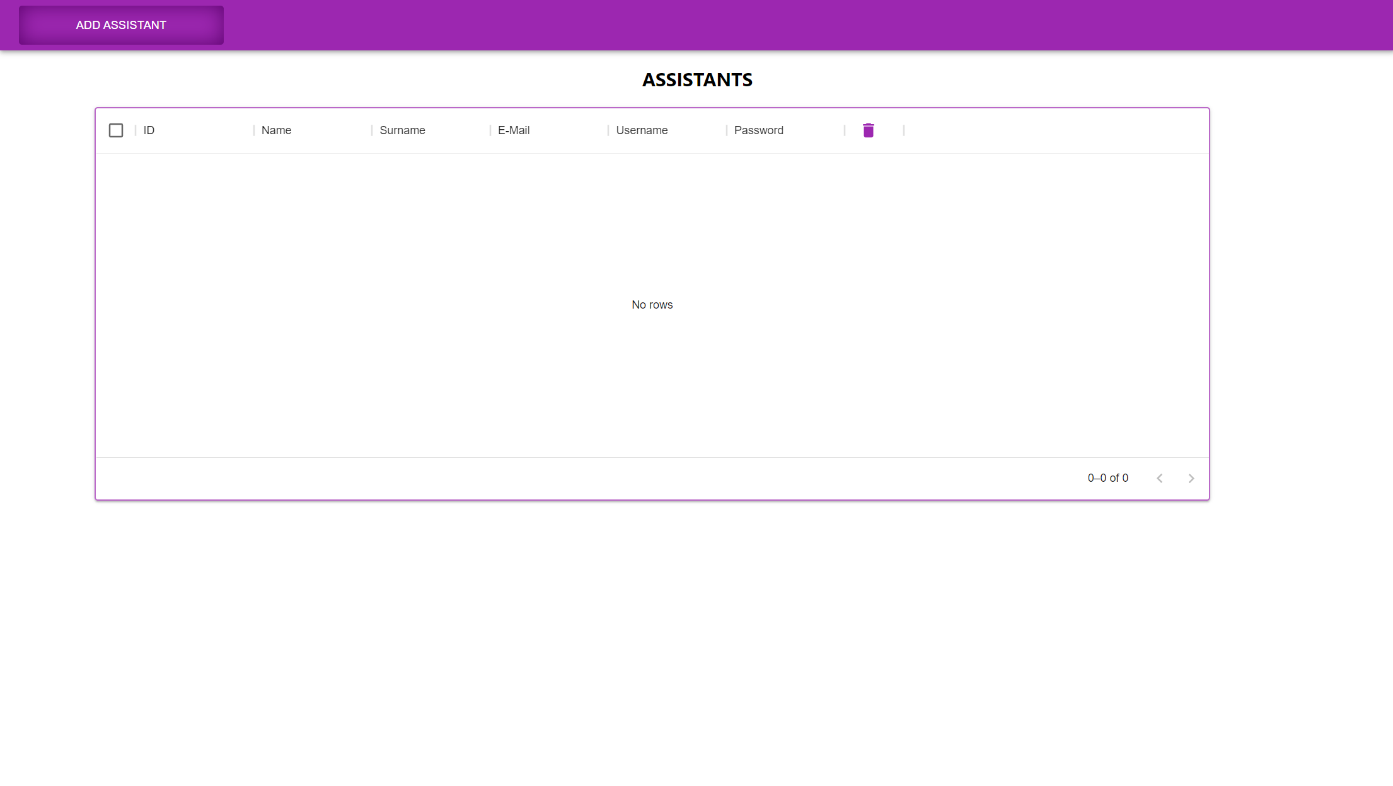
Admin – Add - Assistans

Slide 9
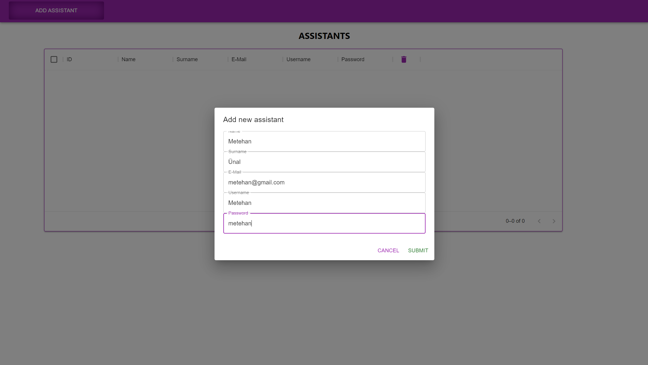
Admin – Add - Assistans

Slide 10
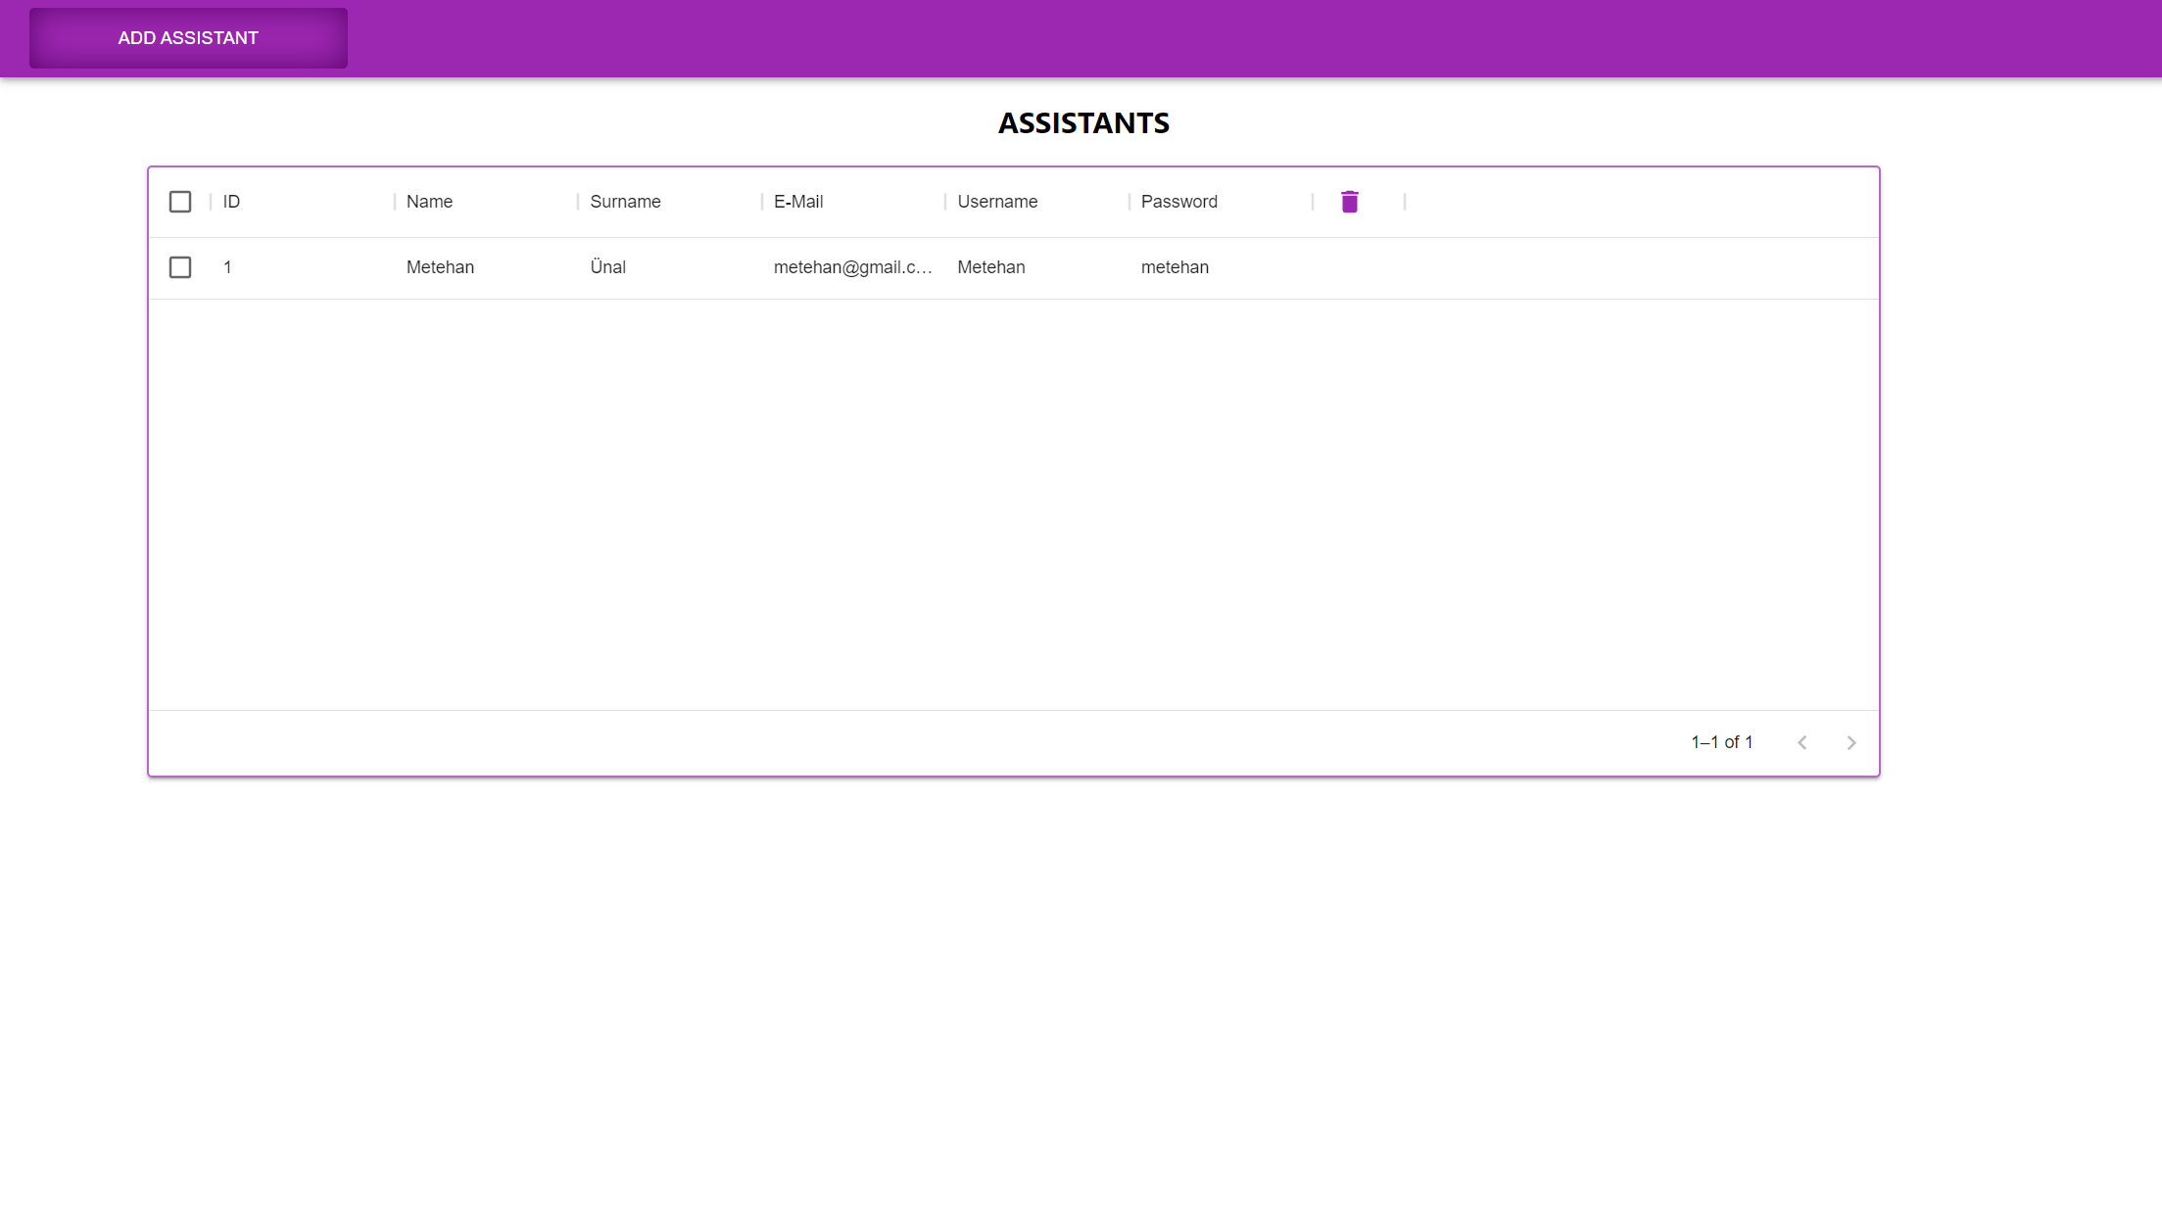
Admin – Add - Assistans

Slide 11
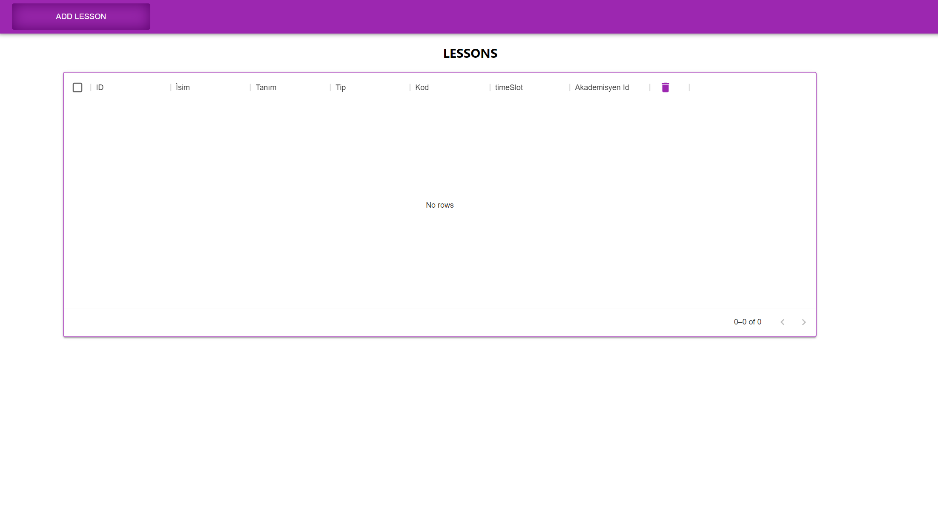
Admin – Add - Lessons

Slide 12
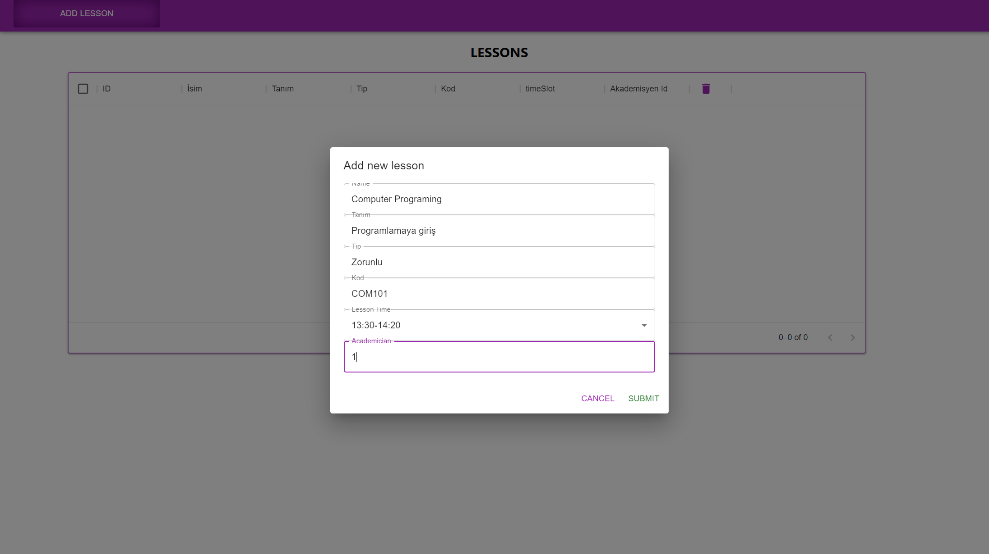
Admin – Add - Lessons

Slide 13
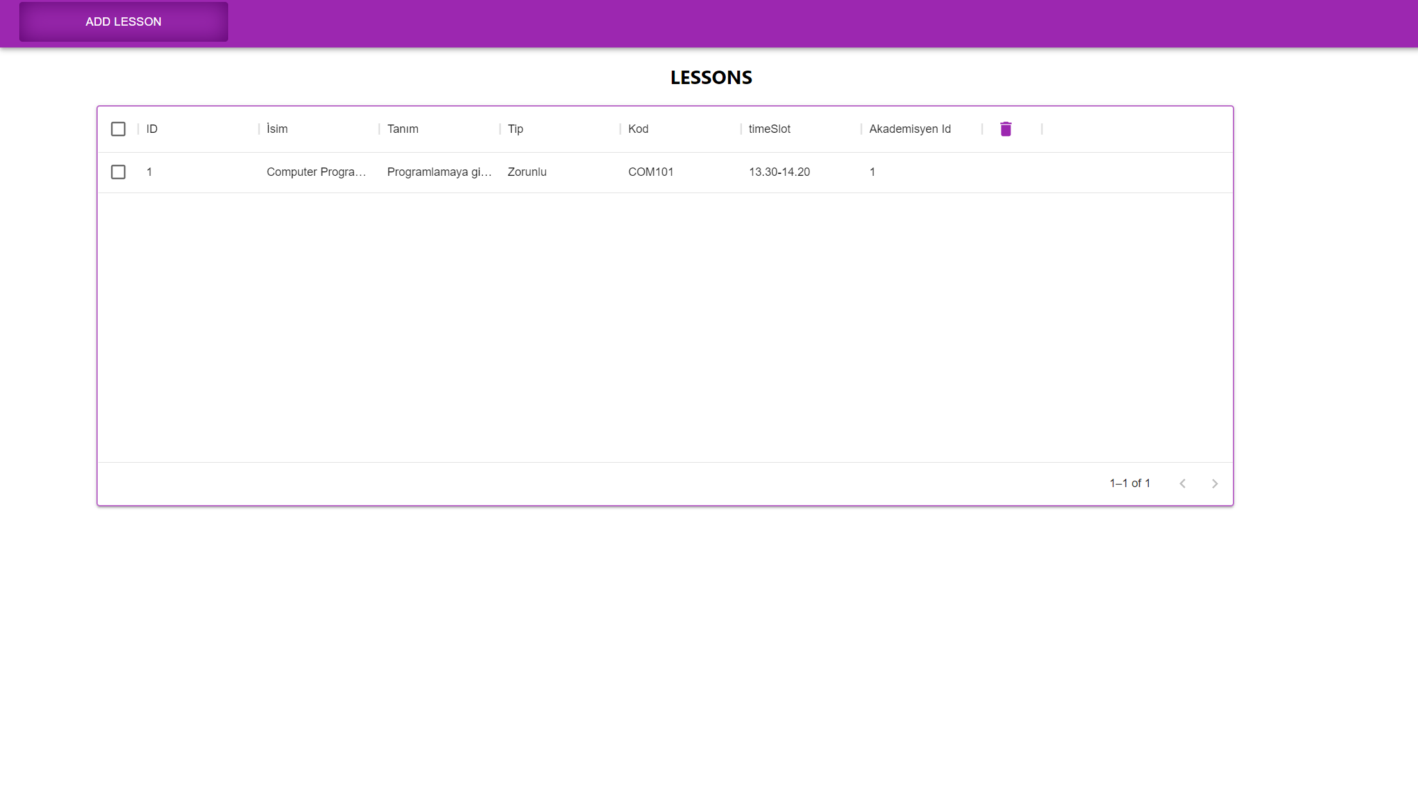
Admin – Add - Lessons

Slide 14
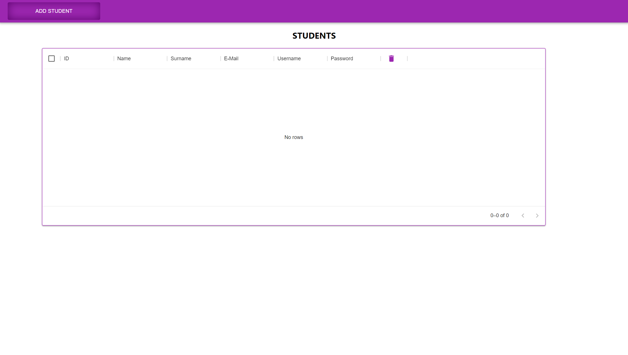
Admin – Add - Students

Slide 15
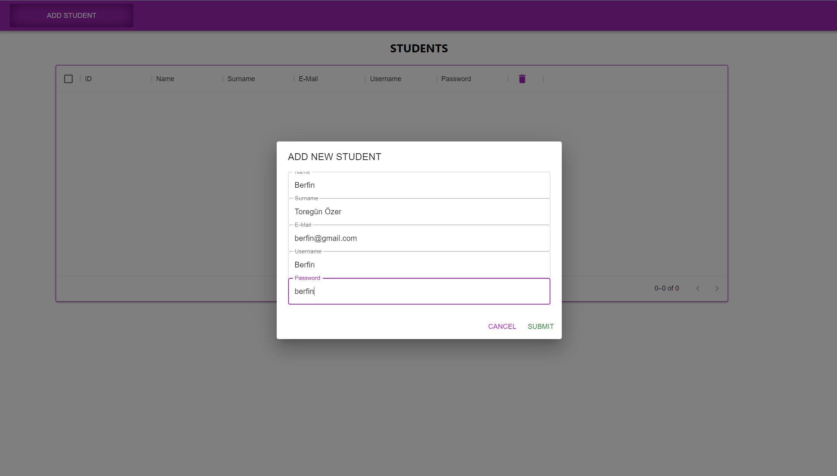
Admin – Add - Students

Slide 16
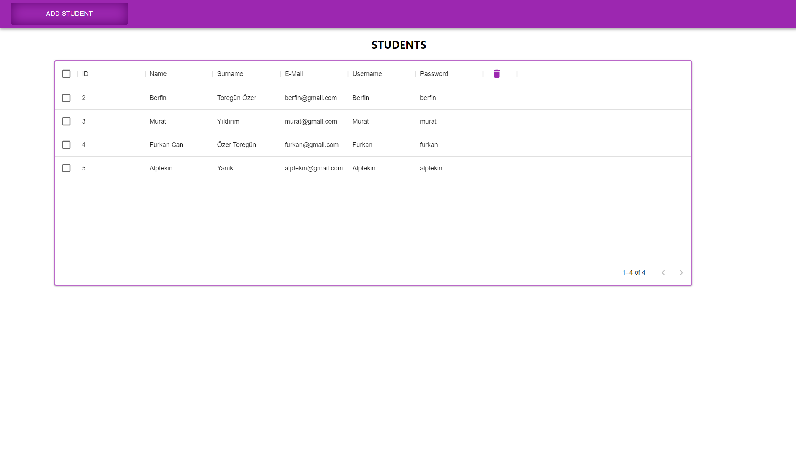
Admin – Add - Students

Slide 17
Academician

Slide 18
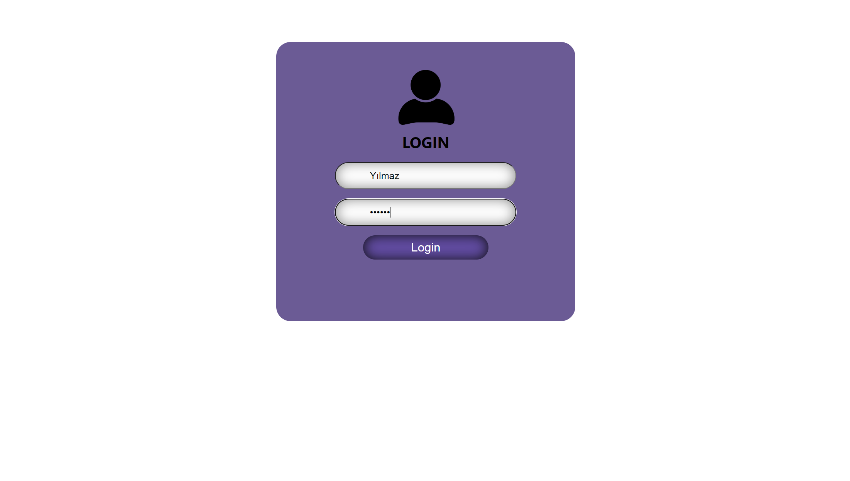
AcademicianLogin

Slide 19
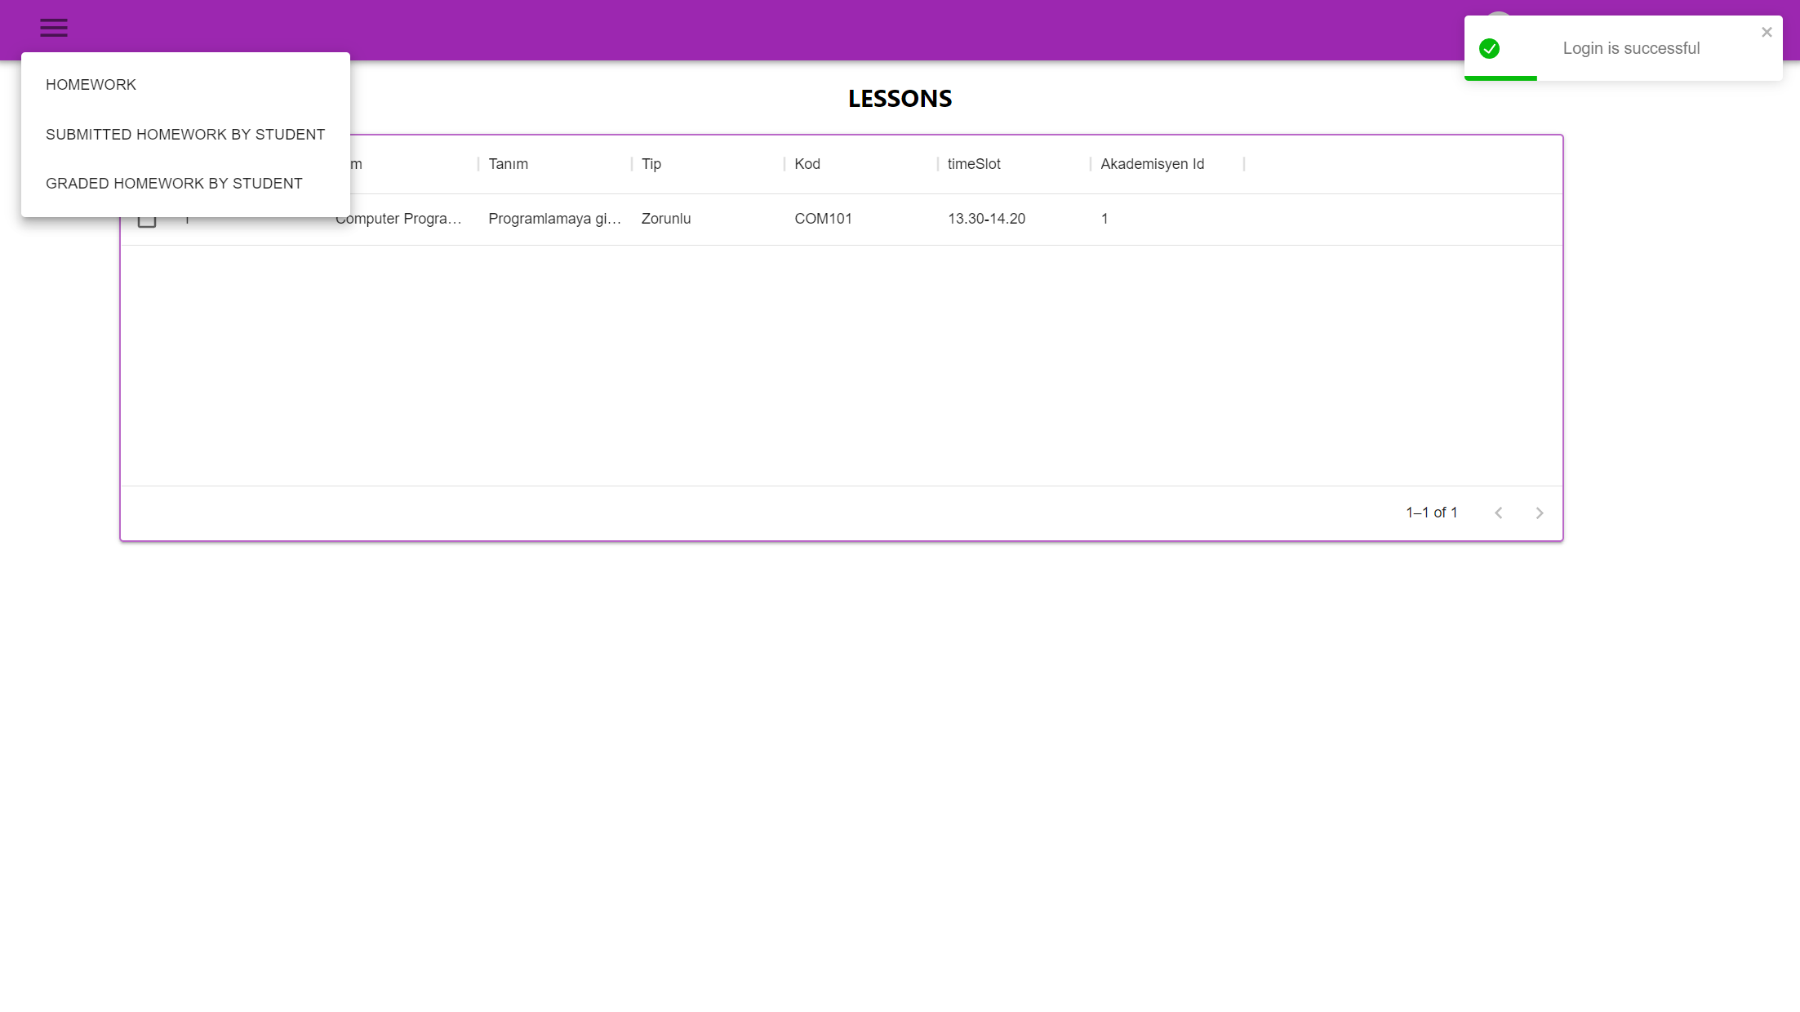
AcademicianMain

Slide 20
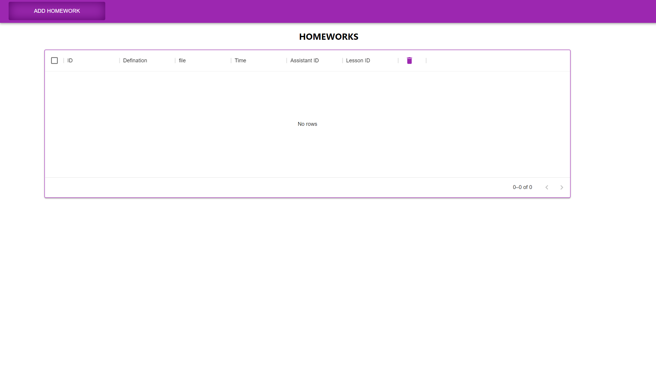
AcademicianHomework

Slide 21
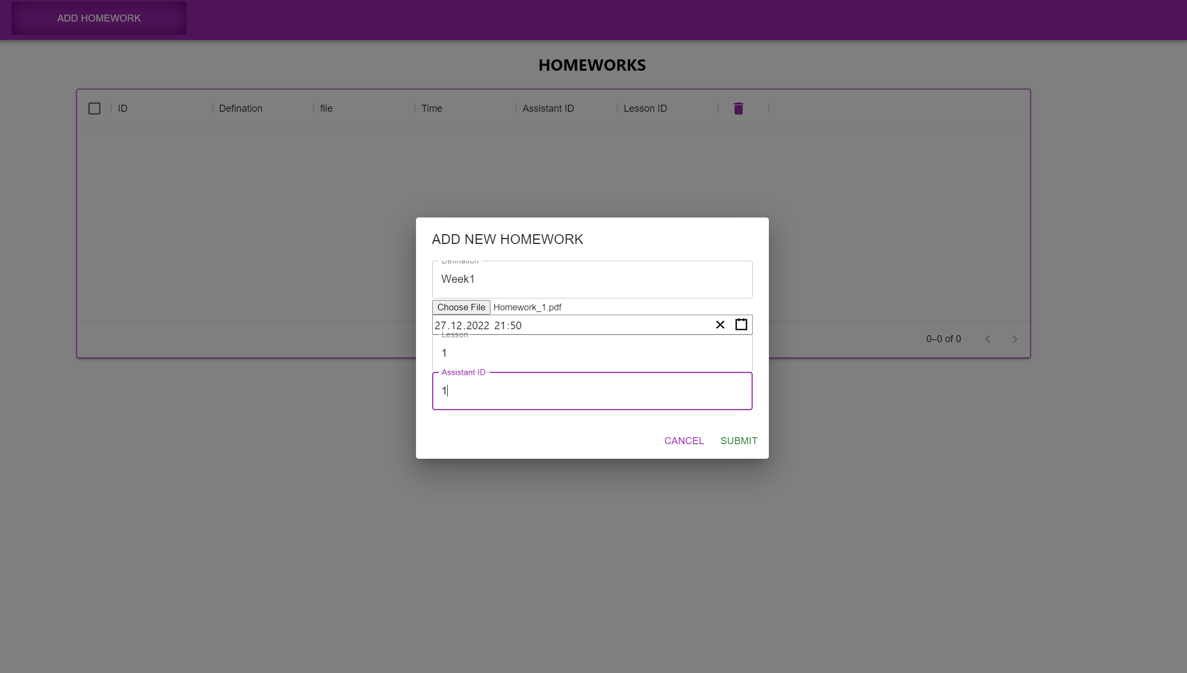
Academician Add Homework

Slide 22
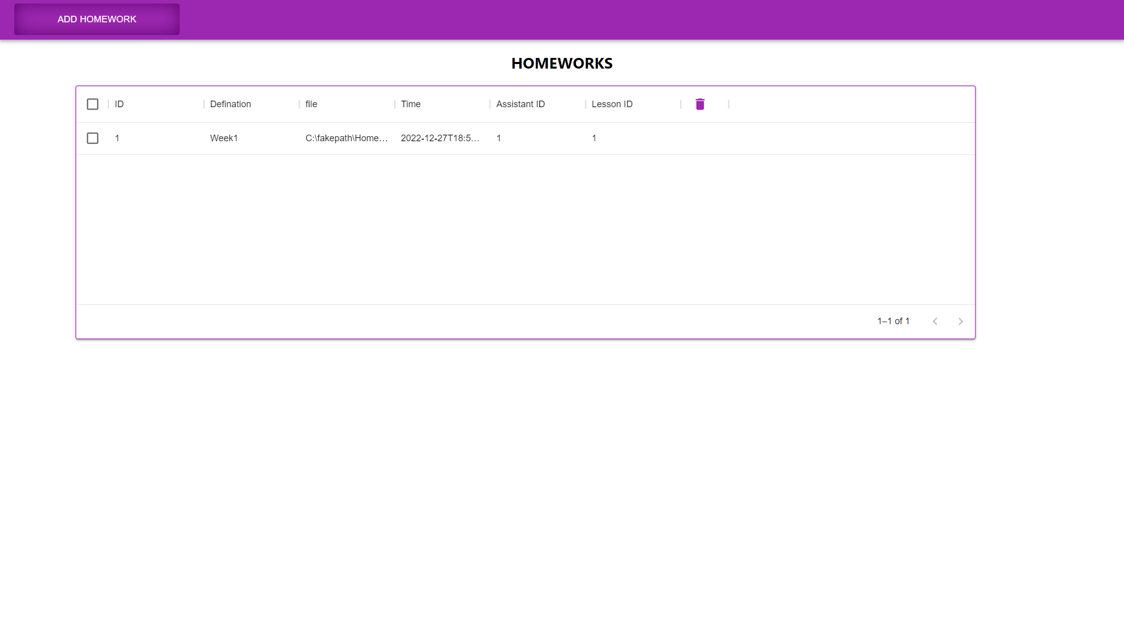
Academician-Add-Homework

Slide 23
Student

Slide 24
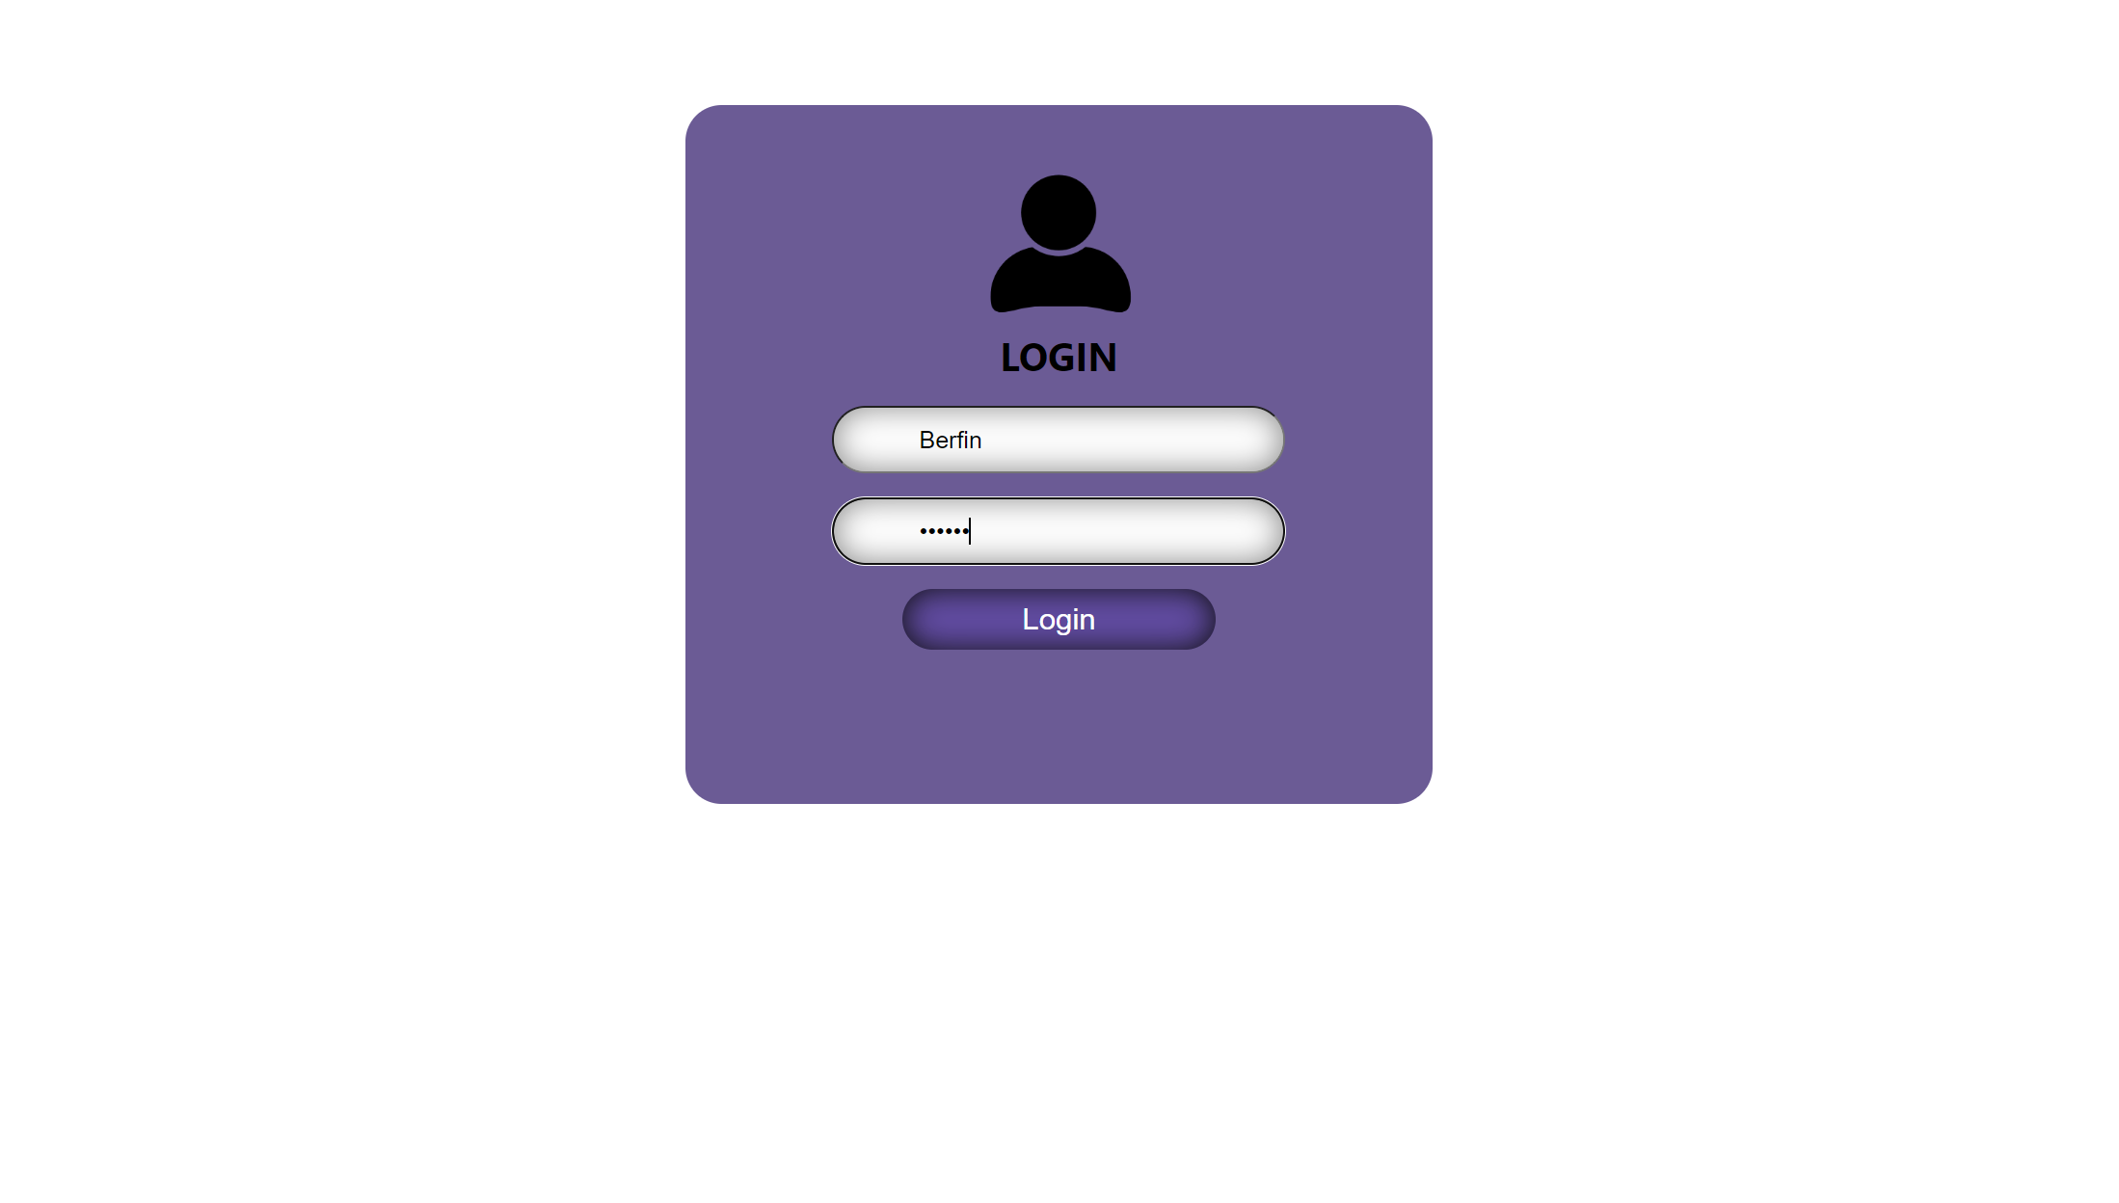
Student Login

Slide 25
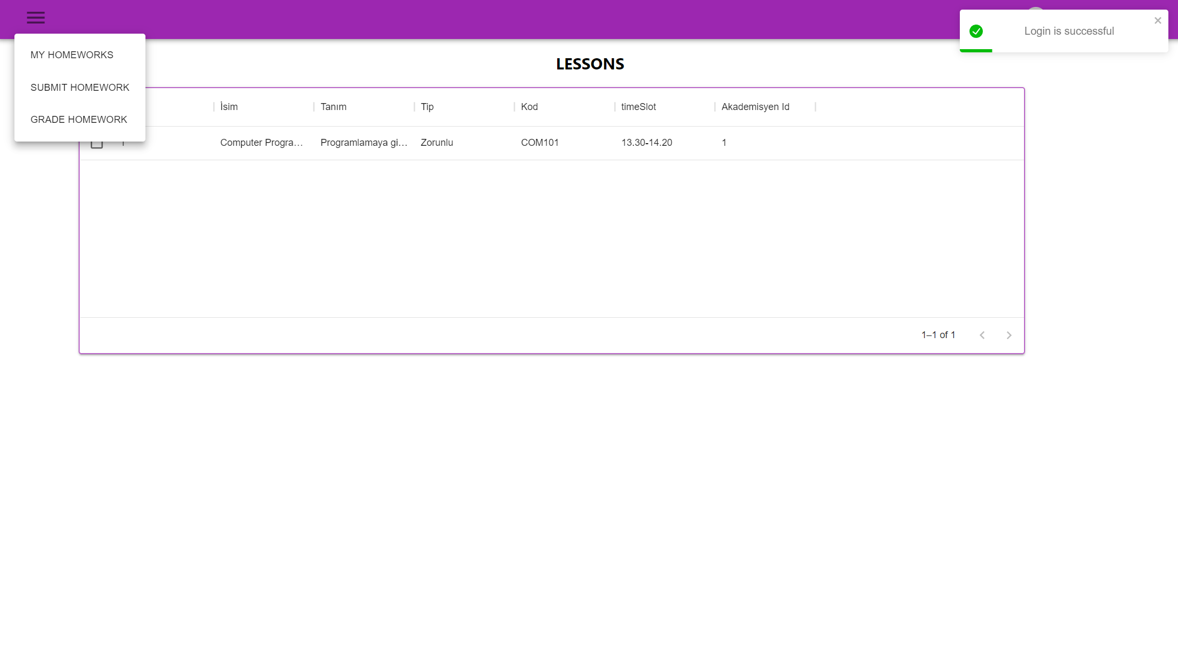
Student Main

Slide 26
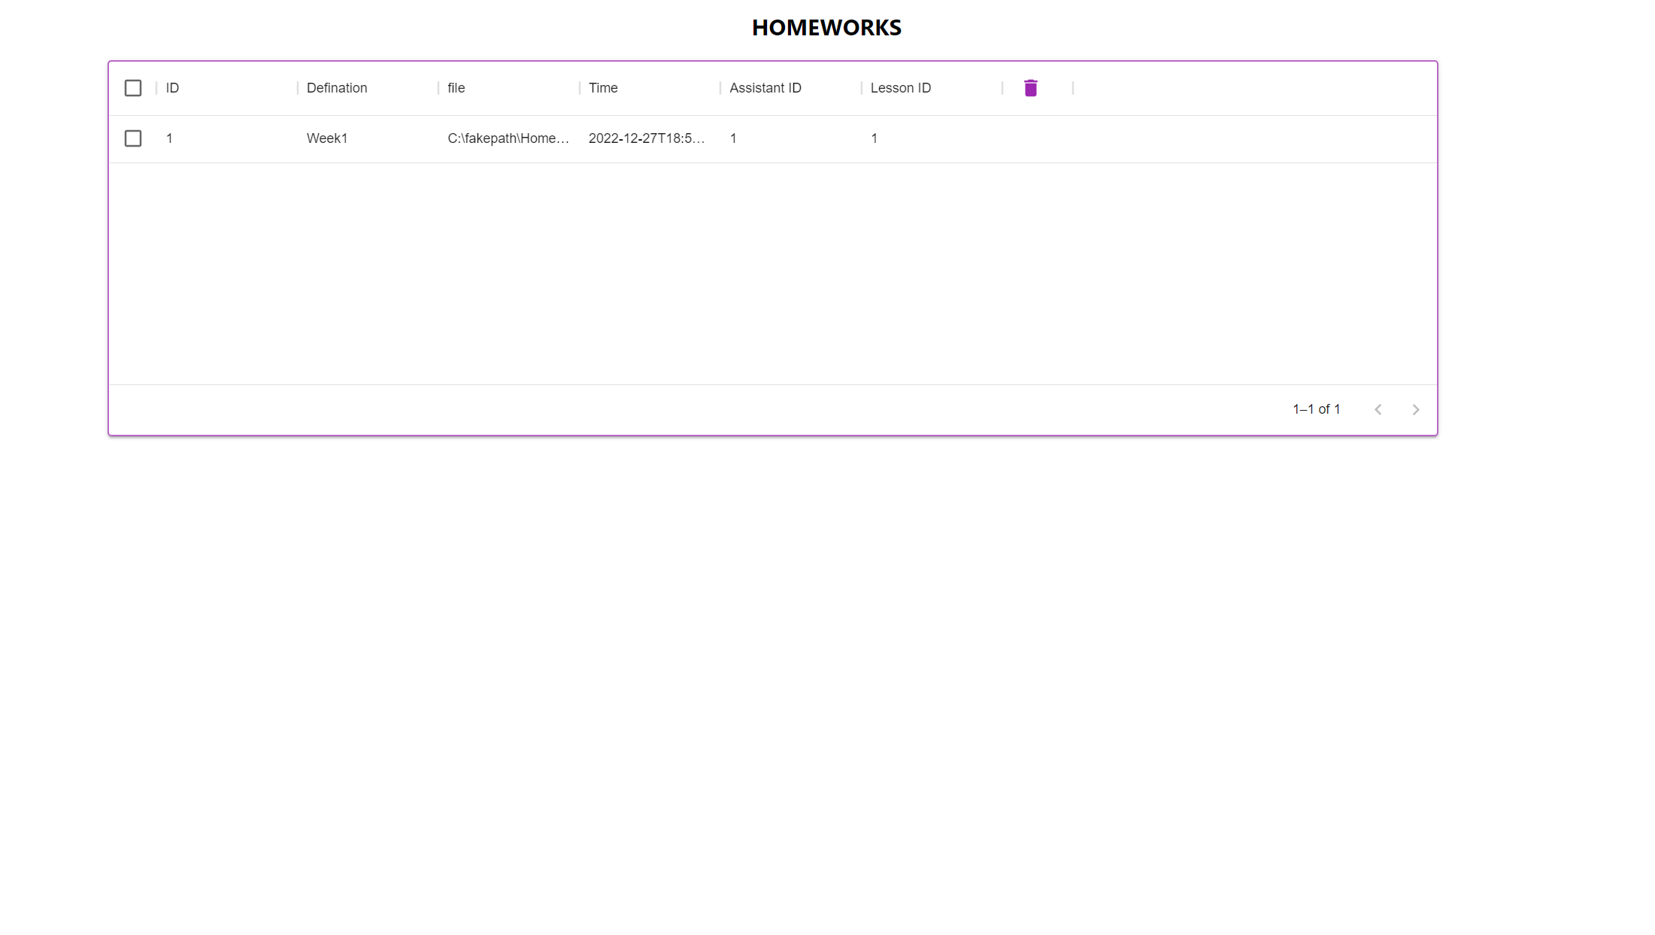
Student Homework

Slide 27
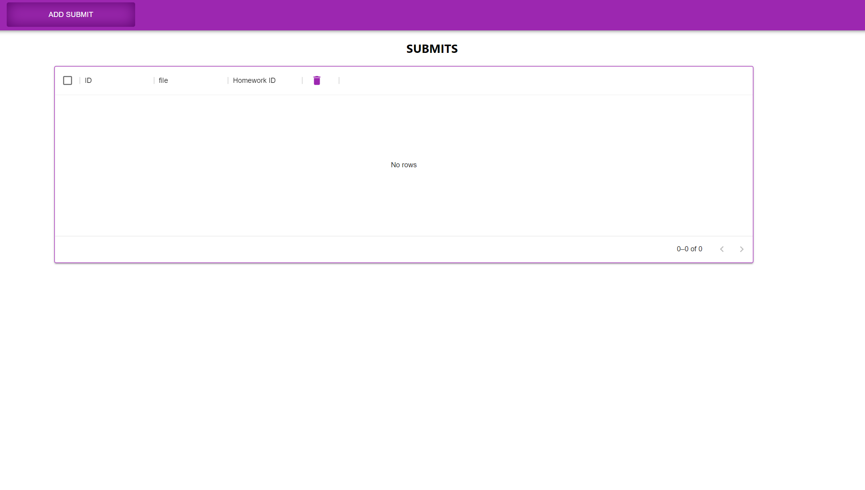
Student Submit Homework

Slide 28
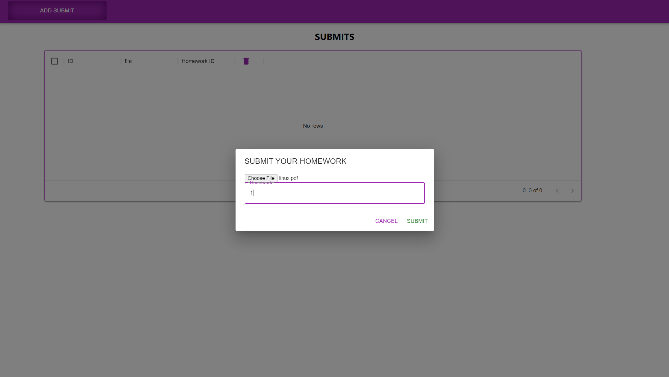
Student Submit Homework

Slide 29
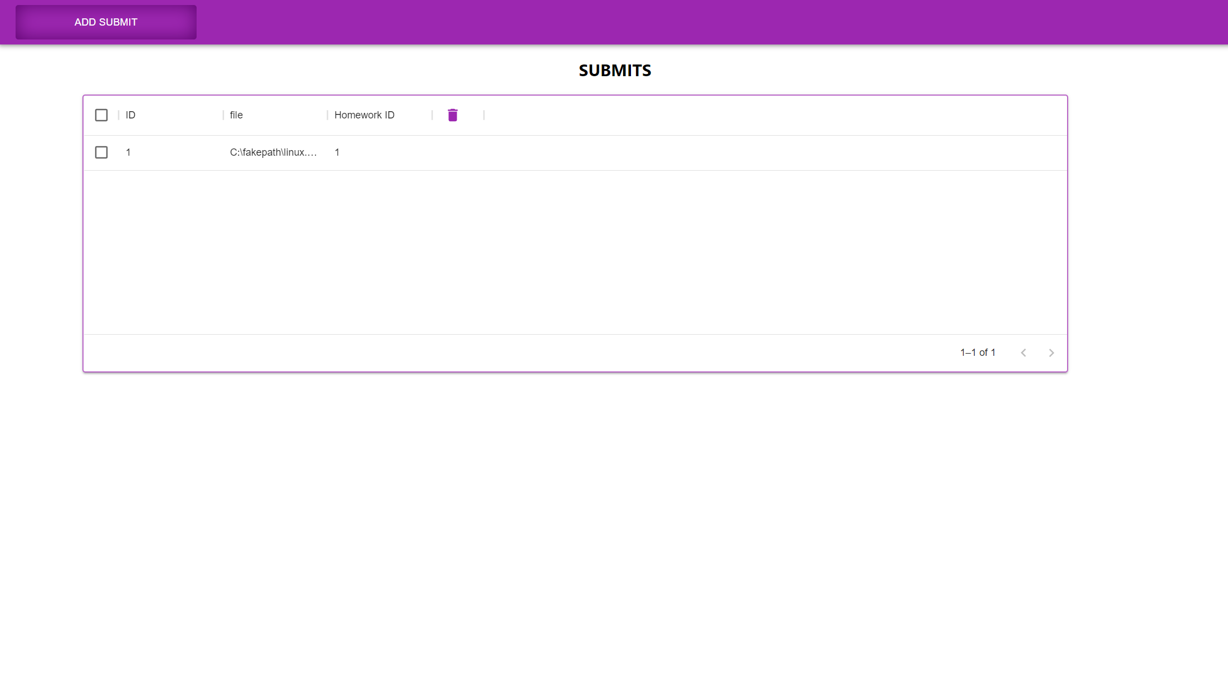
Student Submit Homework

Slide 30
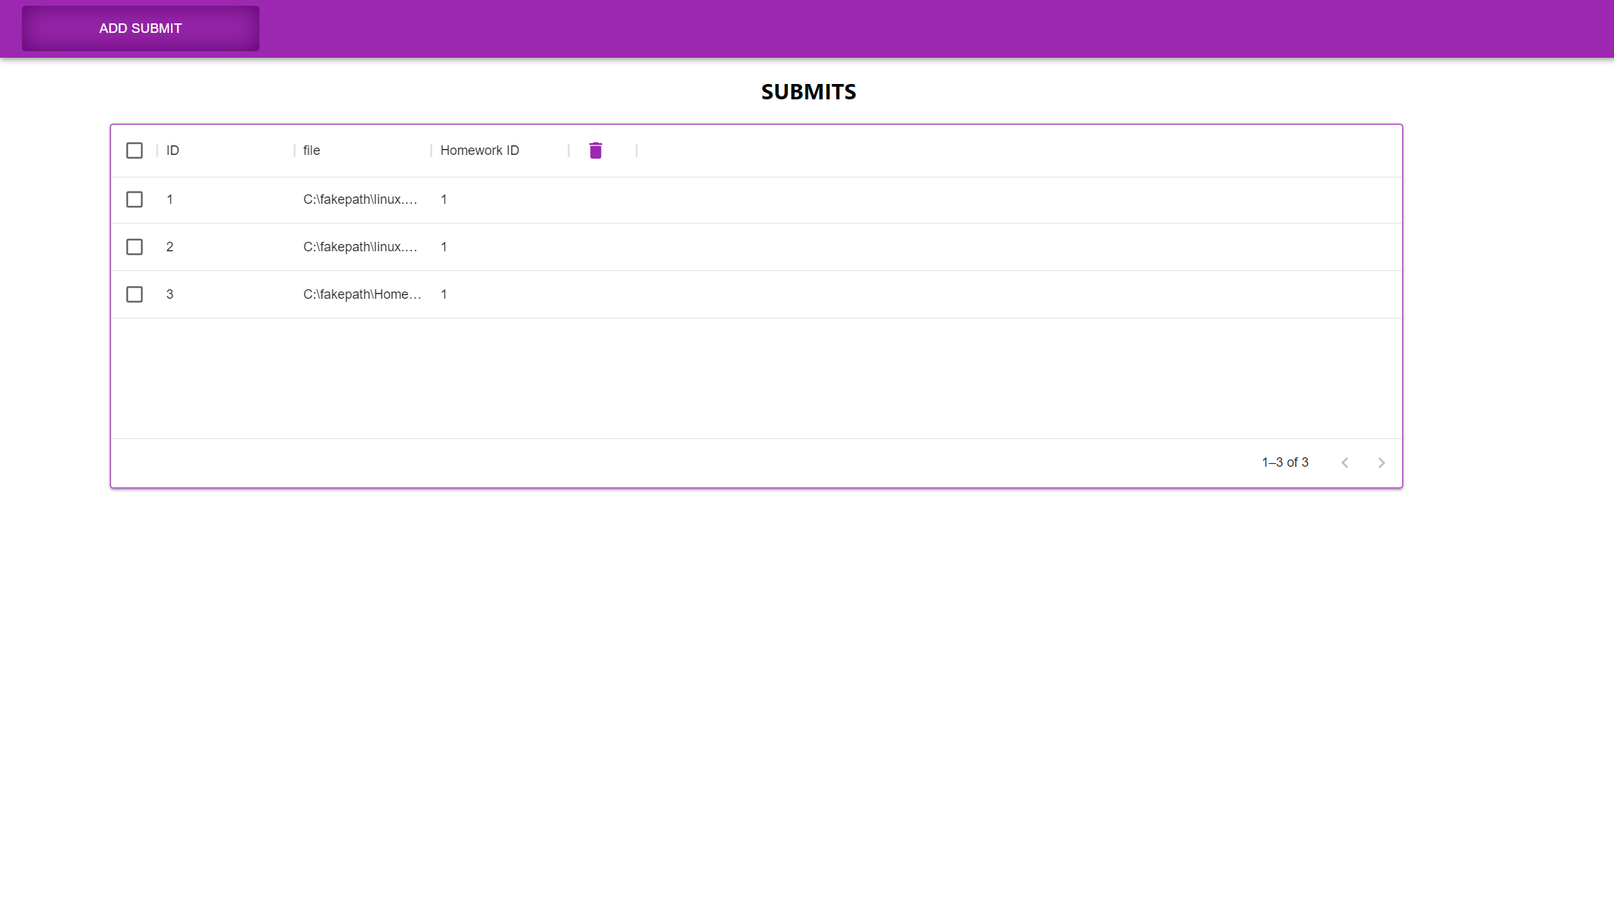
Student Submit Homework (Final)

Slide 31
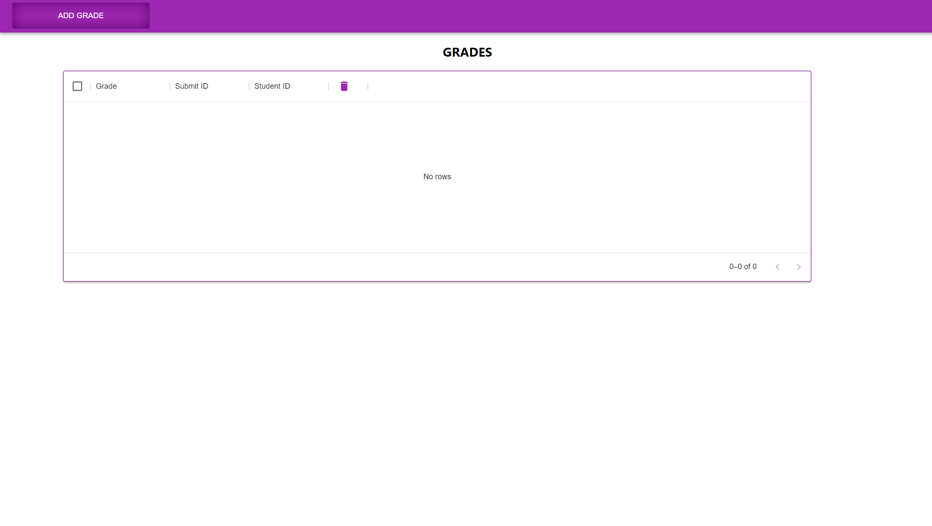
Student Grade

Slide 32
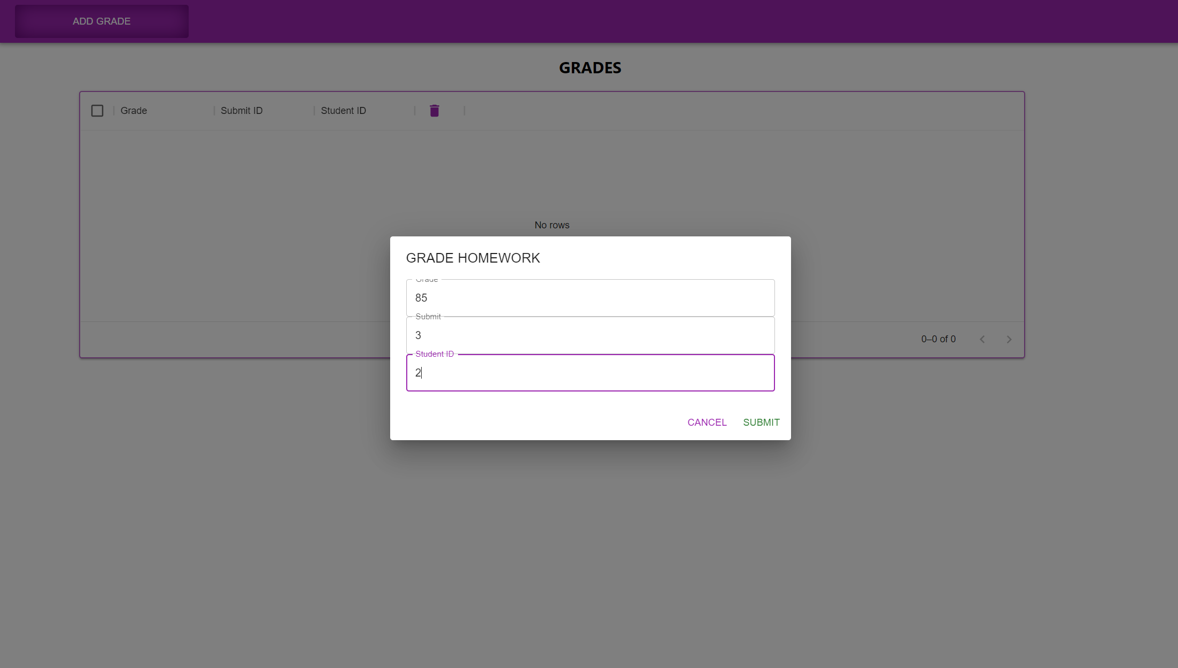
Student Grade

Slide 33
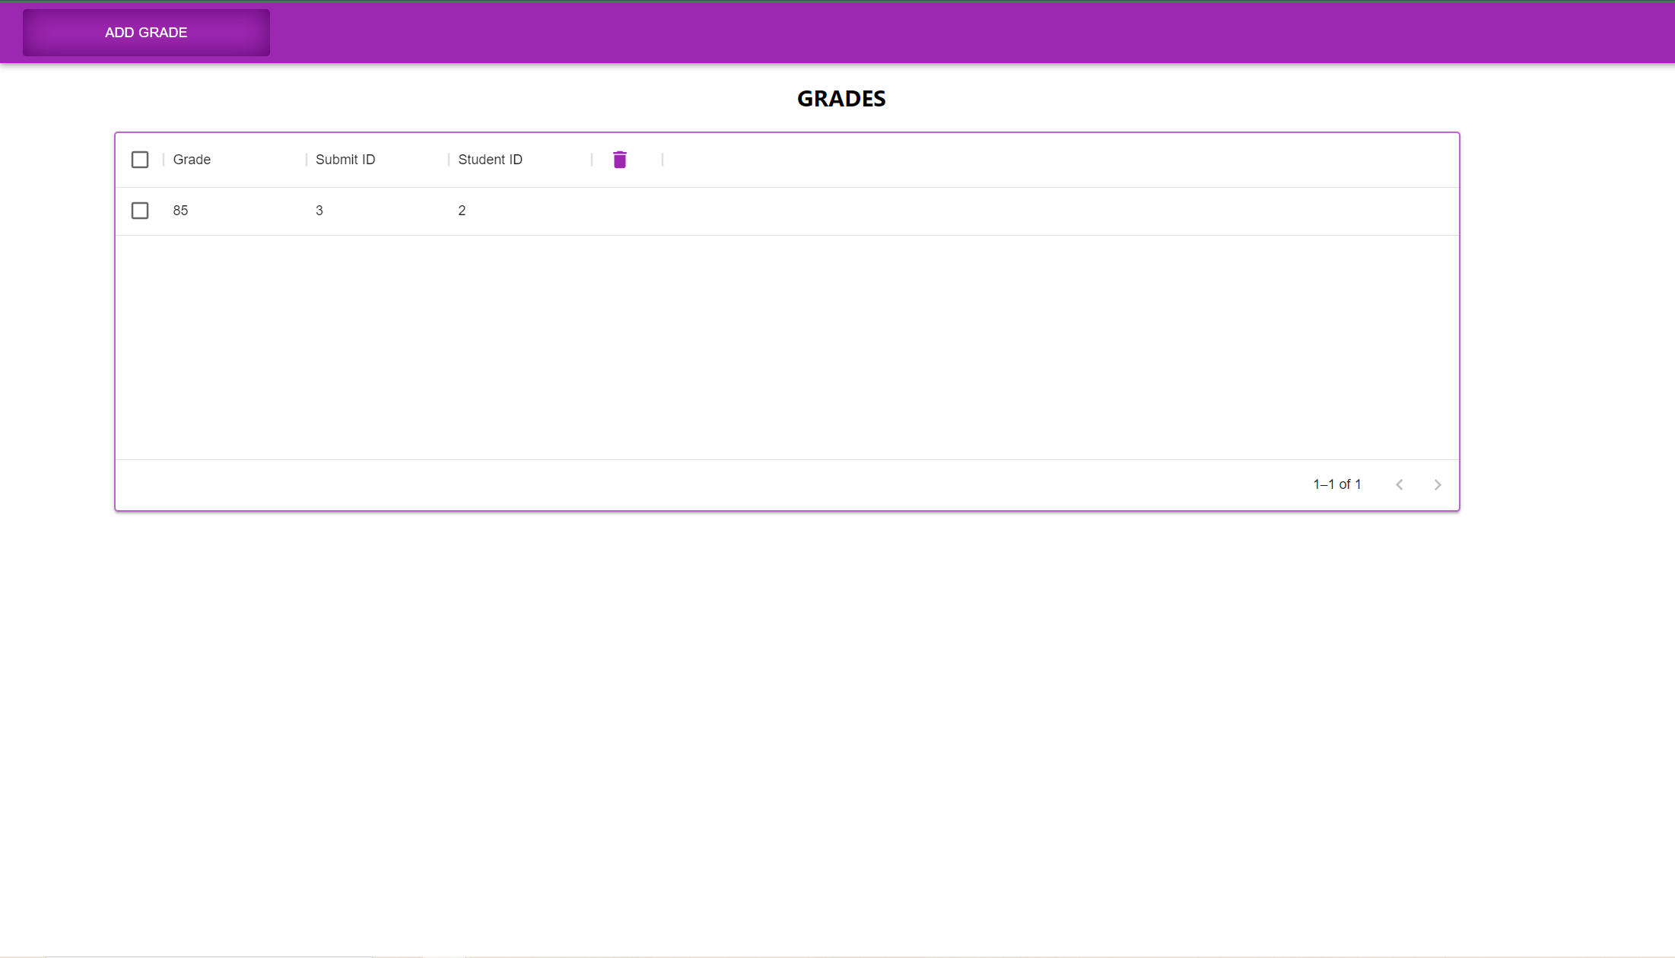
Student Grade

Slide 34
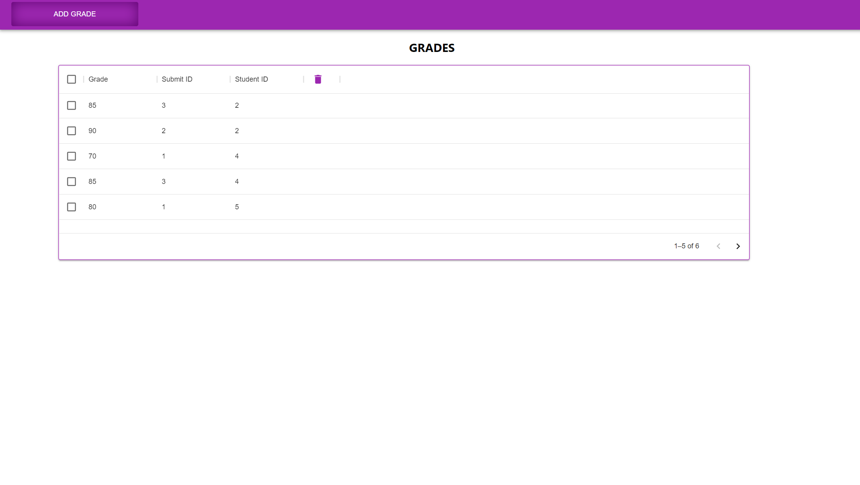
Student Grade (Final)

Slide 35
Academician

Slide 36
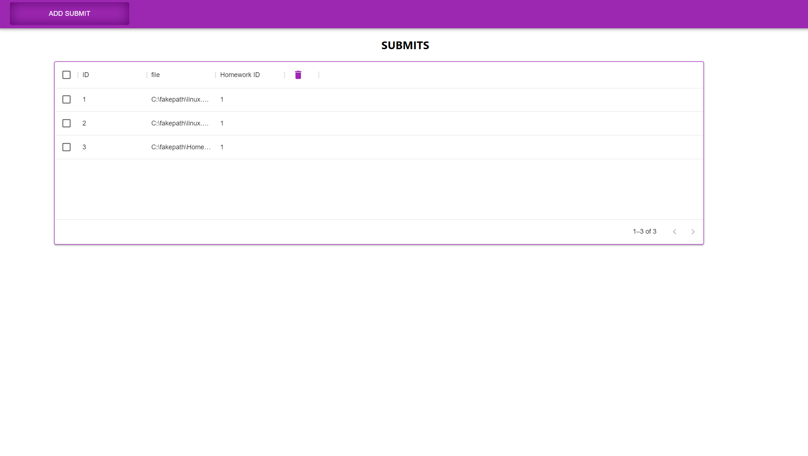
Academician Submit

Slide 37
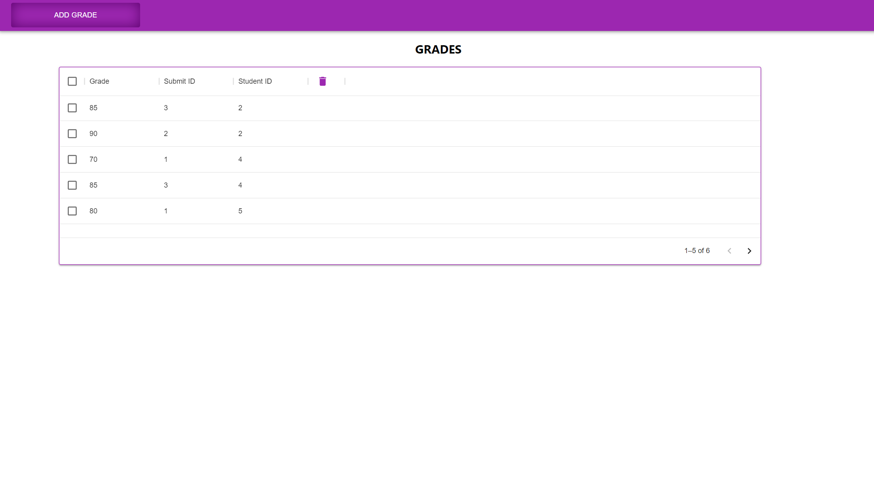
Academician Grade

Slide 38
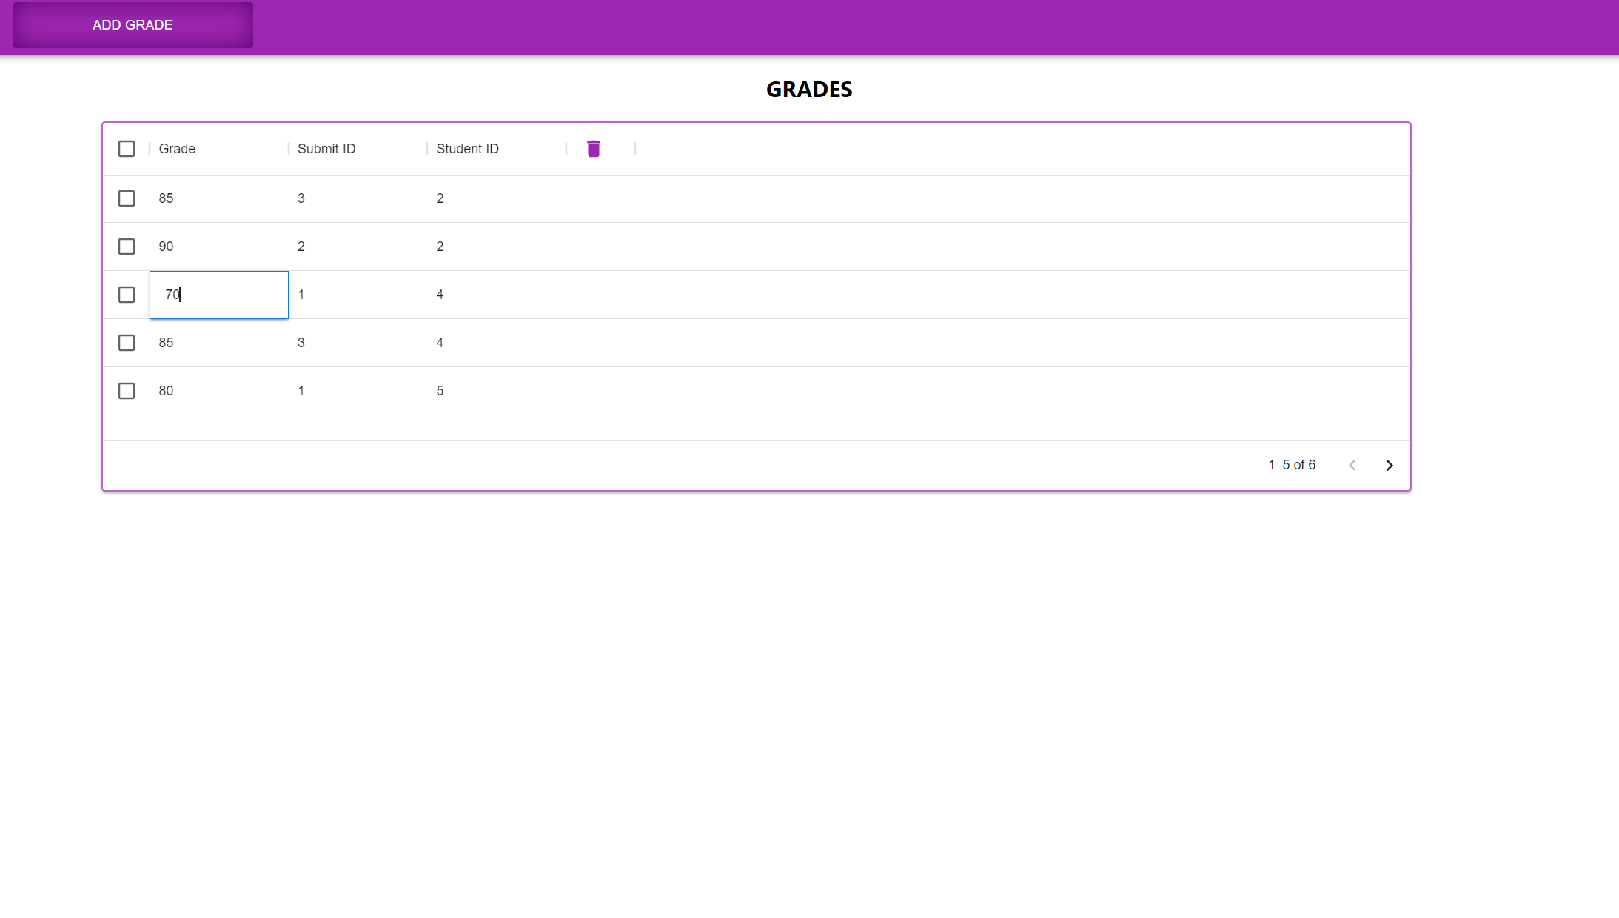
Academician Edit Grade

Slide 39
UML

Slide 40
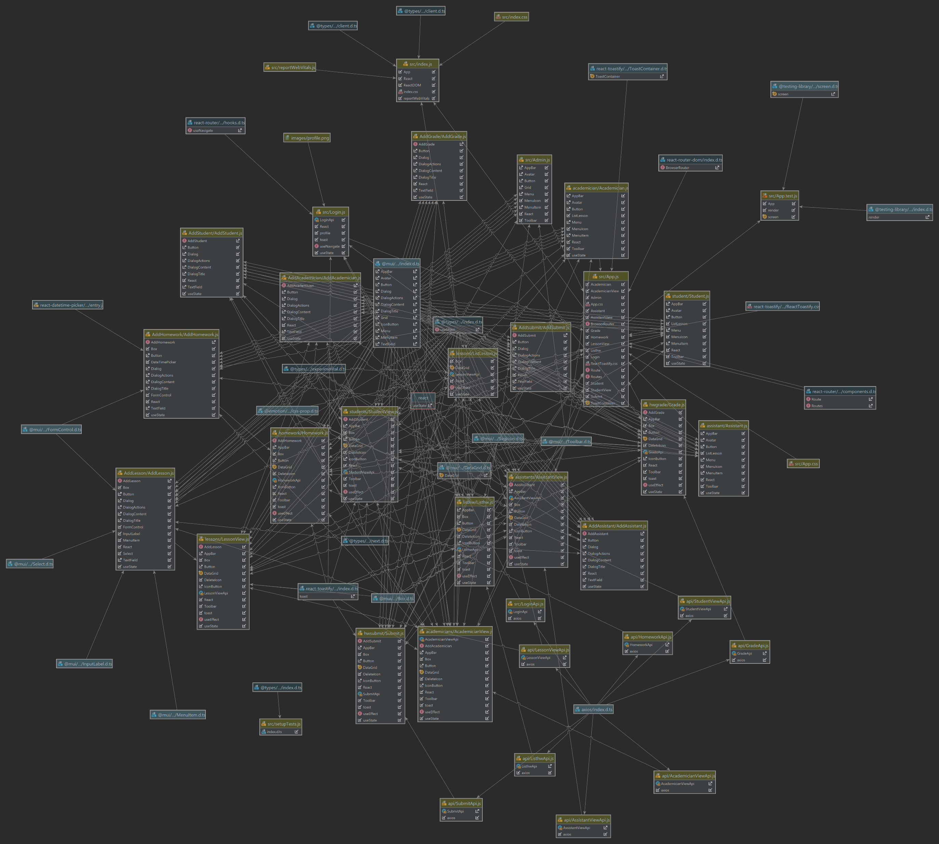
Class Diagram of Frontend

Slide 41
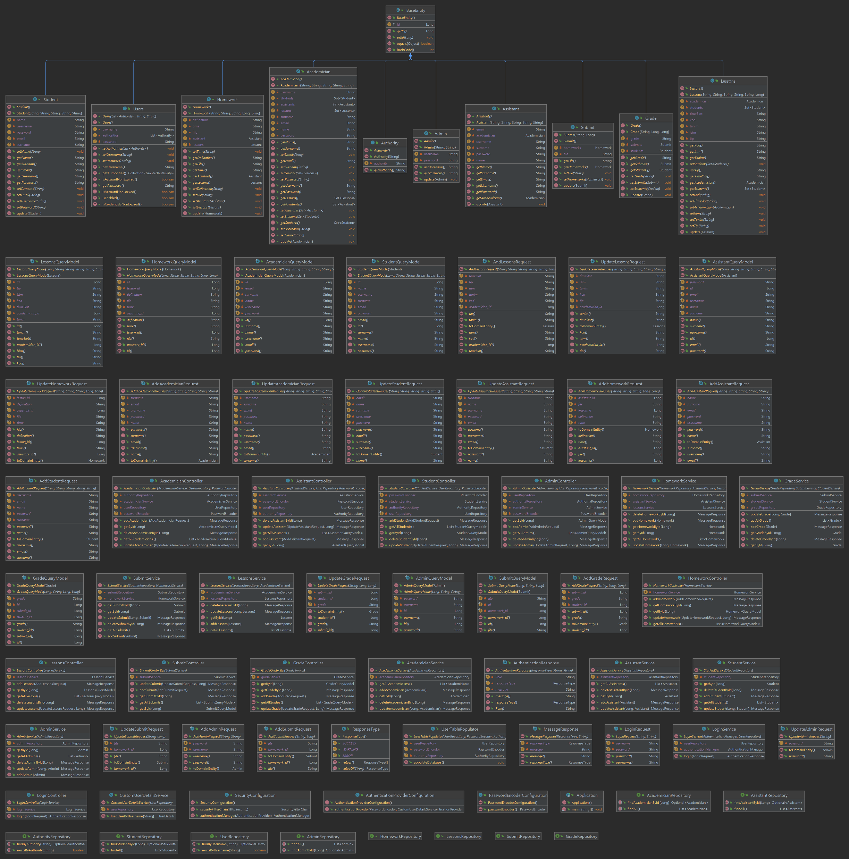
Class Diagram of Backend

Slide 42
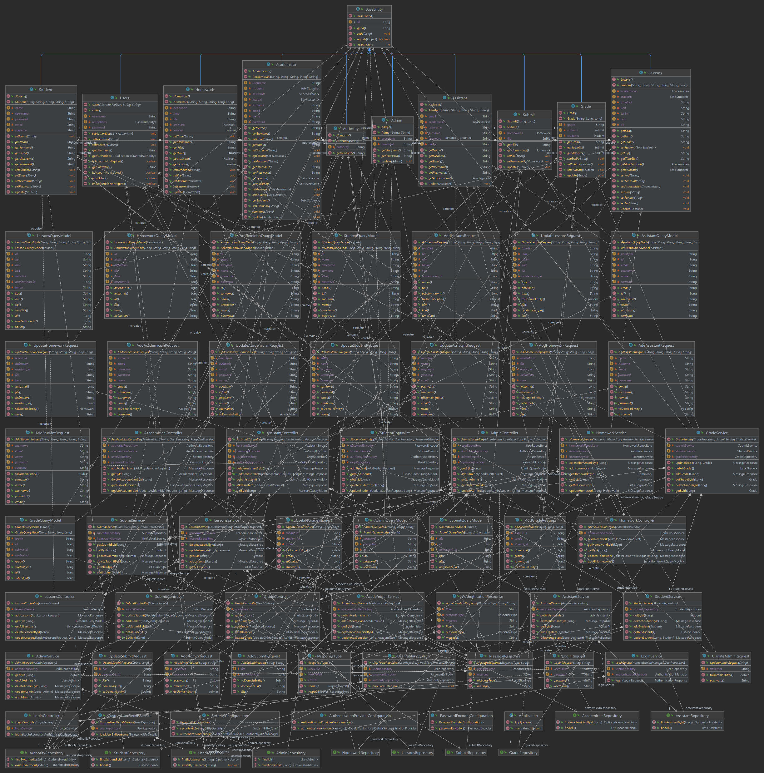
Class Diagram of Backend with Relations

